Slide 1
MockK
Javier Gonzalez

Slide 2


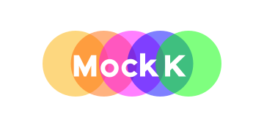

Overview
Tests, a love-hate relationship
EZ Tests = EZ Life
Why?
Mockk vs Mocktio Case Studies

Slide 3
Tests, a love-hate relationship
Love:
They give us more confidence that the code we are writing is fulfilling business use cases.
They give us iterative small scale “wins” when developing.
They protect us from functionality loss when working with a code base.
Hate:
They are “less cool”.
They are “harder to write”.
They have less up-front value in comparison to feature work.

Slide 4
EZ Tests = EZ Life
In a world where tests are easier to write, developers would…
Have a higher likelihood of writing tests out of self motivation.
Versus writing tests to fulfill an arbitrary coverage metric.
Run into less red tape when writing tests that cover edge cases.
Leading to a more comprehensive test suite that questions assumptions.
Be able to write tests quicker, unearthing possible issues earlier in the timeline.
Be enabled to practice a truer form of Test Driven Development.
Find joy in writing tests, making them a lot cooler than folks who find that tests are unnecessary.*
* this opinion is of my own

Slide 5
Why?
Kotlin is described by JetBrains as:
“A modern programming language that makes developers happier”
MockK…
Takes Kotlin’s philosophy, and applies it within the context of a testing framework
Converts boiler plate of setting up tests to simple to read Kotlin-style syntax
Is interoperable with Mockito within test suites, making piecemeal transition possible
Has extended functionalities for spring, and even is referenced specifically in Spring Boot Kotlin tutorials

Slide 6
Mockk vs Mocktio Case Studies
A few code-based case studies will be shown shortly
The purpose of these case studies is to show the differences in approaches between the test frameworks to resolve the following areas of testing:
Static function mocking/verification
Definition of embedded mocks
Companion function mocking/verification

